Slide 1
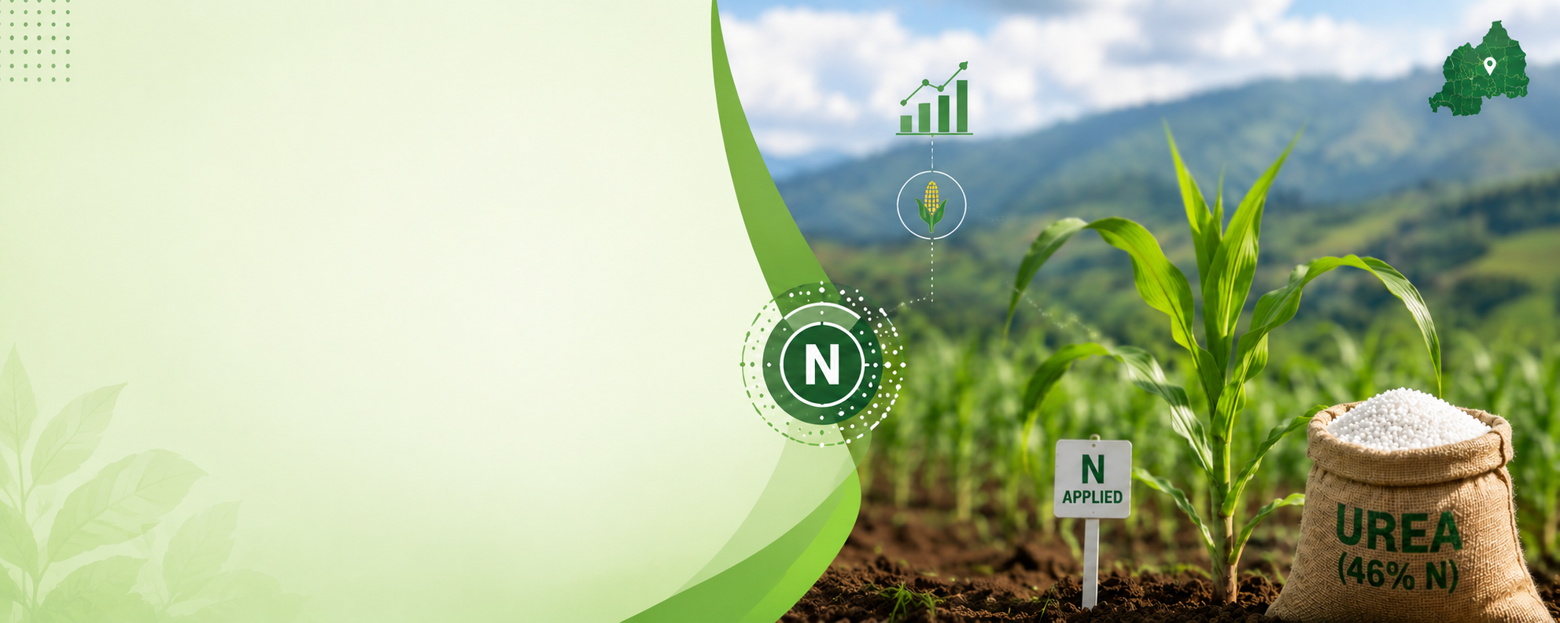
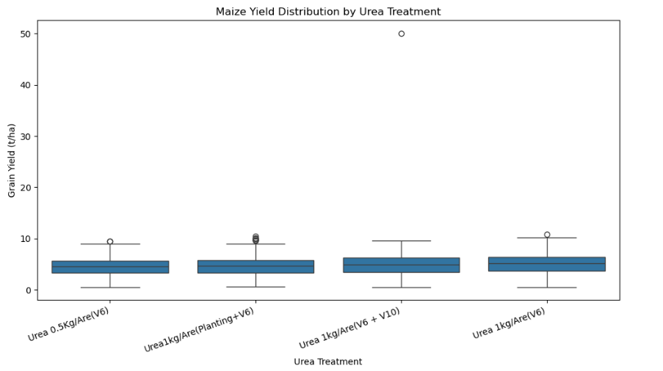
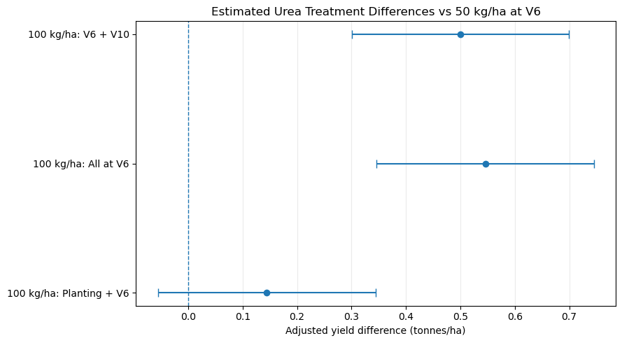
The Problem
Evergreen wants to provide maize farmers in Rwanda better evidence on how much Urea to apply in their farms and when.
Targeted farmers already use different application strategies, but it is not clear to them which approach produces better yields under different growing conditions.
Evergreen acknowledges that applying more fertilizer does not automatically guarantee a better harvest.
Company wants more evidence to help farmers need make more informed fertilizer decisions.

Slide 2
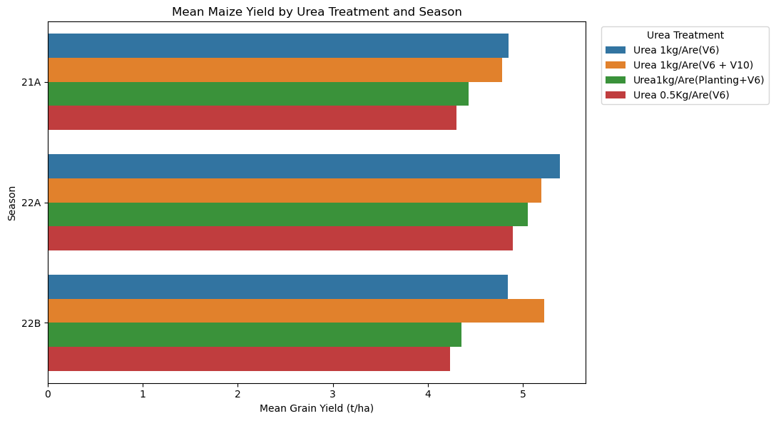
The Solution
Analyzed trial data collected across three growing seasons and several agricultural environments.
Compared four strategies:
  - 50 kg/ha, applied at V6.
  - 100 kg/ha, split between planting and V6.
  - 100 kg/ha, split between V6 and V10.
  - 100 kg/ha, applied entirely at V6.
Examined yields across seasons and agricultural environments.
Used statistical models to compare treatments while accounting for seasonal, environmental and field differences
Central message: Rather than relying on individual farmers' experiences or raw averages alone, we used trial data and statistical analysis to compare the four strategies.

Slide 3
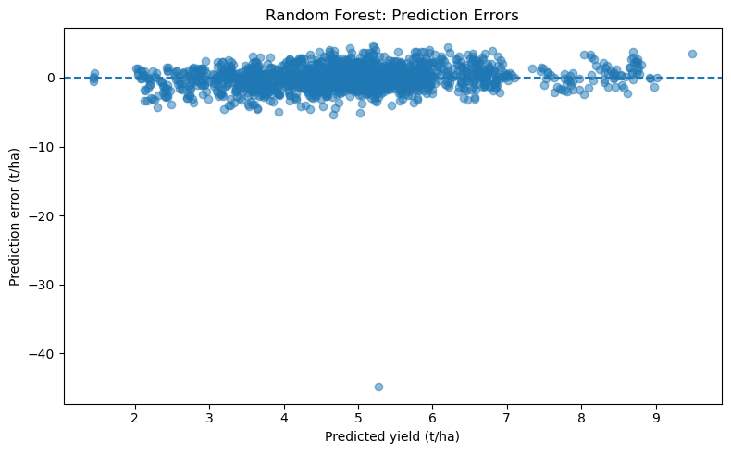
The Outcome
Applying 100 kg of Urea fertilizer per hectares entirely 6 months after planting produced the highest estimated average yield: approximately 5.12 tonnes per hectare.
Splitting the same total amount and applying after 6 and 10 months produced a very similar yield of approximately 5.07 tonnes per hectare.
Both of these strategies produced significantly higher yields than applying 50 kg of Urea fertilizer per hectare entirely 6 months after planting.
Treatments were not significantly different by season or agricultural environment.
Central message: The two strategies that applied 100kg of fertilizer per hectare from 6 months onward after planting performed best on average, but neither was proven superior to the other.

Slide 4
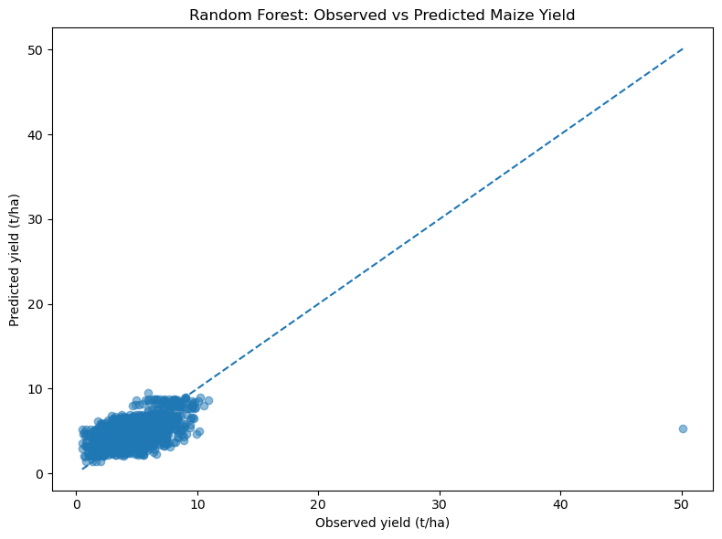
The Implication
There is a promising option to consider:
  Under the conditions represented in this trial, applying 100 kg of fertilizer per hectare entirely 6 months after planting was associated with the highest estimated average yield.
Splitting the application may also be a viable option:
  Applying half of fertilizer at 6 months and half at 10 months produced comparable yields.
  It’s a strategy worth considering as long as the timing and logistics of a second application are manageable.
Central message: More fertilizer is not automatically more profitable. The trial analysis focused on yields, not fertilizer costs, labor, maize prices, or profits.

